Slide 1
Literary Terms
Invisible Man

Slide 2
Imagery
The use of language to evoke a picture or a concrete sensation of a person, a thing, a place, or an experience.

Slide 3
symbolism
A person, place, thing, or event that has meaning in itself, and that also stands for something more than itself.

Slide 4
prologue
An opening to a story that establishes the setting and gives background details, often some earlier story that ties into the main one, and other miscellaneous information.

Slide 5
epilogue
Section or speech at the end of a book or play that serves as a comment on or a conclusion to what has happened.

Slide 6
irony
A discrepancy between appearances and reality.
VERBAL IRONY: occurs when someone says one thing, but really means something else.
SITUATIONAL IRONY: takes place when there is a discrepancy between what is expected to happen, or what would be appropriate to happen, and what really does happen.
DRAMATIC IRONY: Known because it is often used on stage. A character in the play (or story) thinks one thing is true, but the audience or reader knows better.

Slide 7
satire
A type of writing that ridicules the shortcomings of people or institutions in an attempt to bring about a change.

Slide 8
Point of view
The vantage point, or stance from which a story is told. The eye and mind through which the action is perceived and filtered.

Slide 9
reliability
The extent to which a narrator can be trusted or believed. The closer the narrator is to the story, the more his judgment will be influenced by forces in the story.
UNRELIABLE NARRATOR V.S. RELIABLE NARRATOR

Slide 10
Naïve Narrator
Is uncomprehending; narrates the story without realizing its true implications.

Slide 11
taboo
A linguistic taboo is a social prohibition that forbids mentioning a word or subject. Commonly, various cultures might have taboos against mentioning bodily fluids, defecation, certain sexual activities, or certain religious terms.
In Standard American English, words describing specific sexual activities or bodily functions usually are taboo for polite conversation.

Slide 12
Rite of passage
An incident which creates tremendous growth signifying a transition from adolescence to adulthood.

Slide 13
stereotype
A character who is so ordinary or unoriginal that the character seems like an over simplified representation of a type, gender, class, religious group, or occupation.
Type of STATIC CHARACTER.

Slide 14
allegory
Derived from the Greek word, allegoria (“speaking otherwise”).
Loosely describes any writing in verse or prose that has a double meaning. Narrative acts as an extended metaphor in which persons, abstract ideas, or events represent not only themselves on the literal level, but they also stand for something else on the symbolic level.
Usually involves moral or spiritual concepts.

Slide 15
trickster
Tricksters are archetypal, almost always male, characters who appear in the stories of many different stories. Tricksters love to play tricks on gods, humans, and animals.
“Boundary-crossers” in that they cross both physical and social boundaries.
Tricksters are often travelers and tend to break societal rules.
Blur the connections and distinctions between right and wrong, sacred and profane, clean and dirty, male and female, young and old, living and dead.

Slide 16
Picaresque Novel
A humorous novel in which the plot consists of a young knave or rascal misadventures and escapades narrated in comic or satiric scenes.
This roguish protagonist; called a picaro, makes his (or sometimes, her) way through cunning and trickery rather than through virtue or industry.
The picaro frequently travels from place to place engaging in a variety of jobs for several masters and getting into mischief.
The picaresque novel is usually episodic in nature and realistic in its presentation of the seamier aspects of society.

Slide 17
Gothic novel
A type of romance wildly popular between 1760 up until the 1820s that has influenced the ghost story and horror story. The stories are designed to thrill readers by providing mystery and blood-curdling accounts of villainy, murder, and the supernatural.

Slide 18
bildungsroman
Coming of age story.
Genre of the novel which focuses on the psychological and moral growth of the protagonist from youth to adulthood. Change is; thus, extremely important.

Slide 19
kunstleroman
German for “artist’s novel.”
Class of bildungsroman.
Apprenticeship novel. Deals with the youth and development of an individual who becomes – or is on the threshold of becoming a painter, musician, or poet.
Usually ends on a note of arrogant rejection of the commonplace life.

Slide 20
Quest novel
A novel that conveys an adventurous journey that the protagonist has undergone. The protagonist is able to overcome the many obstacles that he meets on the way, and returns with the benefits of knowledge.

Slide 21
Propaganda novel
A novel written to convert the reader to the author’s stand on a social question.
Also known as a social problem novel. The prevailing problem is usually based on gender, race, or class prejudice, and is dramatized through its effect on the characters of a novel.
Usually limits itself to the exposure of a problem. A personal solution may be arrived at by the novel’s characters, but the author does not insist that it can be resolved.

Slide 22
Slave narrative
A narrative, often autobiographical in origin, about a slave’s life, perhaps including his original capture, his punishments and daily labor, and his eventual escape to freedom.

Slide 23
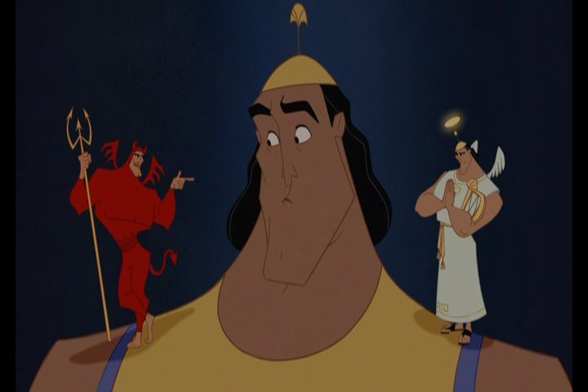
Freudianism
Sigmund Freud – originator of Psychoanalysis
Psychoanalysis focuses on the unconscious aspects of personality.
According to Freud the human mind is like an iceberg. It is mostly hidden in the unconscious.
The EGO, the ID, and the SUPEREGO.

Slide 24
MOTIF: A conspicuous, recurring element, such as a type of incident, a device, a reference, or verbal formula which appears frequently in works of literature.
MOTIF STRAND: A series of motifs in conjunction with other sets of motifs.

Slide 25
Annotations for Invisible Man
The expectations for annotations will be a bit different.
Motif strand chart

